Slide 1
Apprenticeships
What you need to know
18 June 2018

Slide 2
Let’s bust some myths!

Slide 3
Myth 1
Apprenticeships are for people doing plumbing and hairdressing

Slide 4
Digital Marketer Fitness Instructor Engineer Business Executive Receptionist Procurement Animal Stylist Lawyer Groom Print Process Technician Production Engineer Laboratory Scientist Sheet Metal Engineer Dental Nurse Infrastructure Technician IT Technician Aircraft Engineer Software Developer Website Designer
Notes:
170 industries, from advertising to youth work and from environmental engineering to legal
Apprenticeships are available in 1500 job roles, and increasing all the time

Slide 5
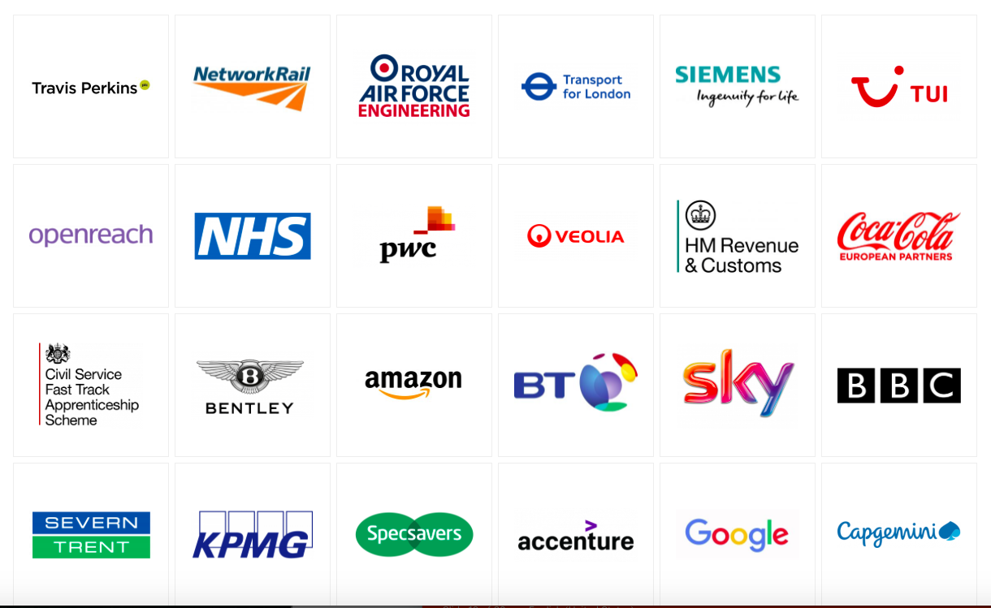
Notes:
Some national companies that run schemes – some here in our region.

Slide 6
Myth 2
Apprenticeships are for students who get poor grades

Slide 7
Personal qualities & qualifications
Problem solver: happy to ask for help but equally someone who can think and work things out themselves
Good interpersonal skills: to work with clients or colleagues
Usually need 5 or more GCSEs A*-C or 4-9 including English and maths – sometimes higher
Some require A levels
Notes:
Grades aren’t usually the main reason an employer selects a candidate and they’re more likely to look for personal qualities

Slide 8
Myth 3
Apprentices don’t get paid.

Slide 9
They do – and it varies
£3.50 an hour, but often more. Including time for training and holiday.
At Cambridge University Press starting salary for entry level apprenticeship is c.£14,300. This rises mid-way through based on performance, and again on completion of the apprenticeship, to c.£18,900
Degree apprenticeships can be between £15,000 and £25,000

Slide 10
Myth 4
If you do an apprenticeship,
you can’t then do a degree.

Slide 11
Levels
Level 2
Level 3
Level 4
Level 5
Intermediate level
Equivalent to 5 GCSEs passes at 9-4
Often an option if still need to pass Maths & English.
Advanced level
Equivalent to 2 A Levels / Level 3 diploma / IB
Progression on from GCSEs
Higher level
Equivalent to a foundation degree
After completion of A Levels or Level 3 in the same area.
Degree level
Degree
After completion of A Levels or Level 4 in the same area or a degree in a different subject
.

Slide 12
Myth 5
If you want to do an apprenticeship,
you go to Cambridge Regional College

Slide 13
Many forms of training
You can but there are lots of training providers including specialists like 3aaa for digital and IT, CSR for sciences, West Suffolk College, College of Animal Welfare, Anglia Ruskin University, etc.
Can be one day a week, two week blocks, or more, sometimes residential, or online or simply assessment in the workplace.

Slide 14
Questions
Why do this instead of going to university or straight into employment?

Slide 15
If you want to earn as well as learn.
If you know what you want to do.
If you learn by doing.
If university doesn’t appeal but you want a qualification.
If you want to gain experience.

Slide 16
How to find roles?

Slide 17
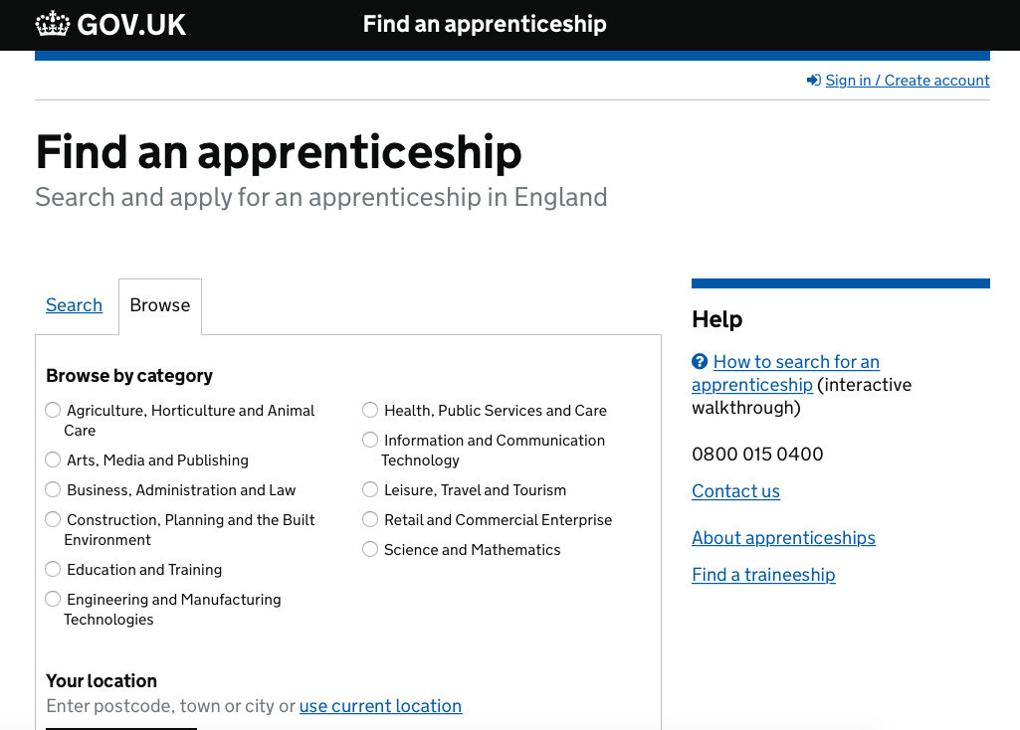

Slide 18
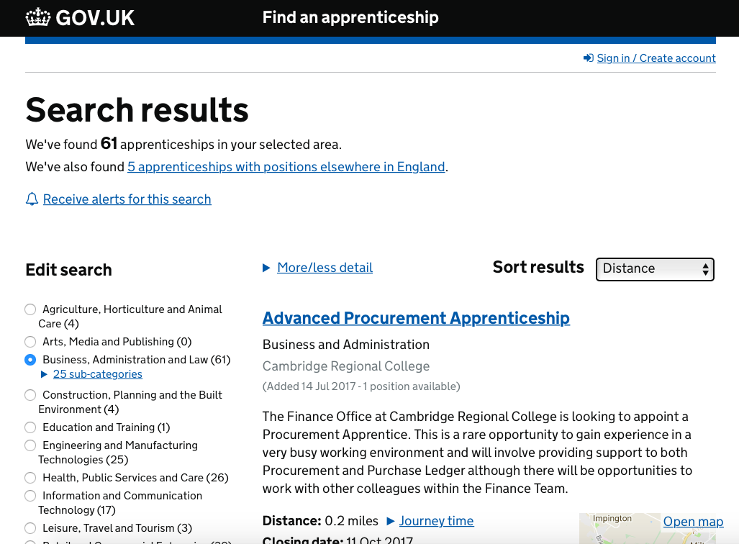

Slide 19
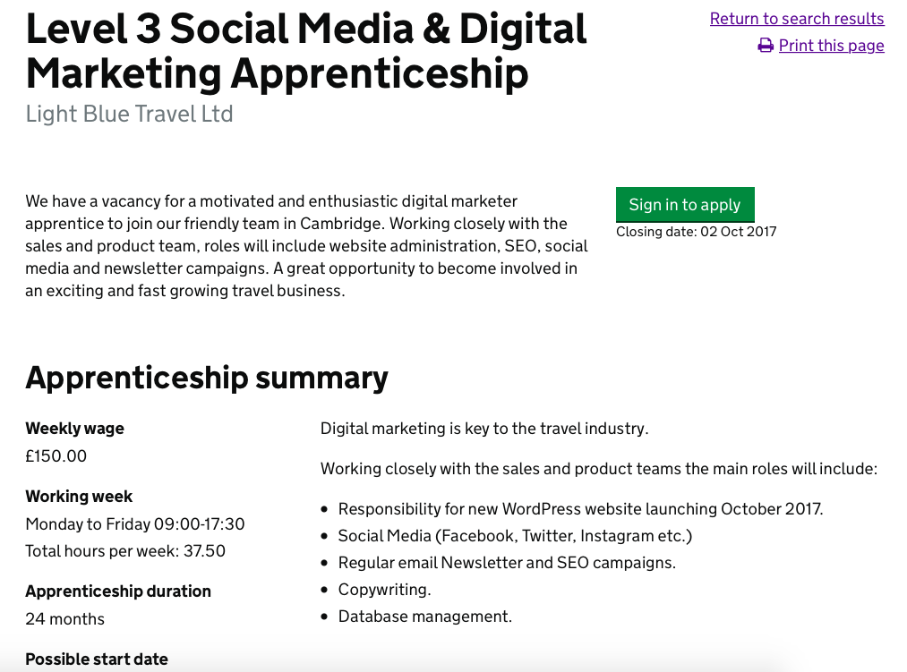

Slide 20
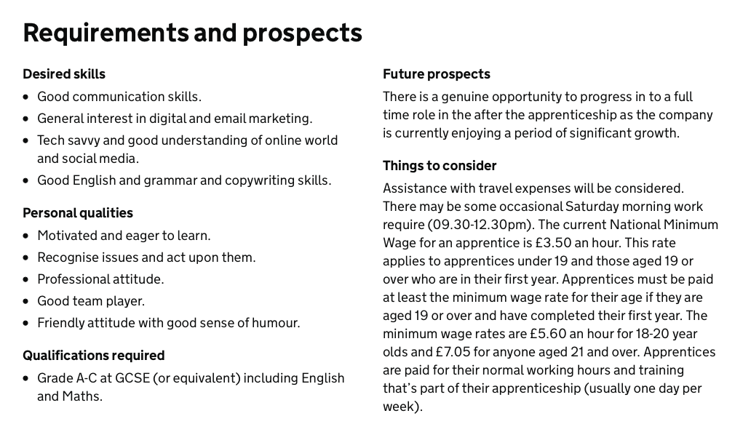

Slide 21
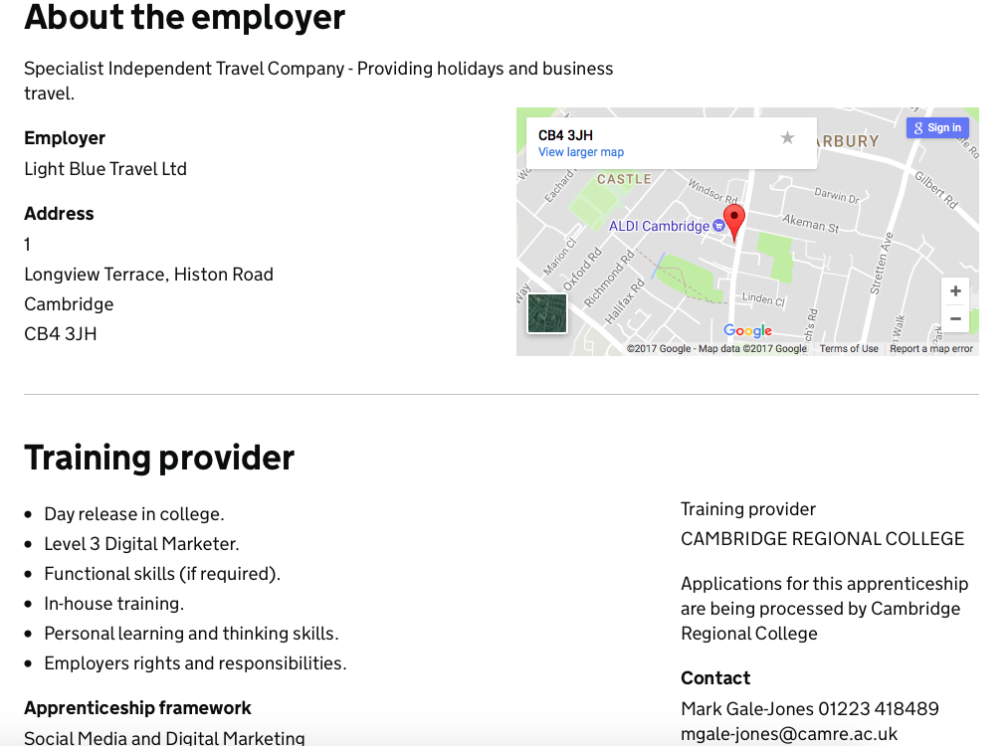

Slide 22
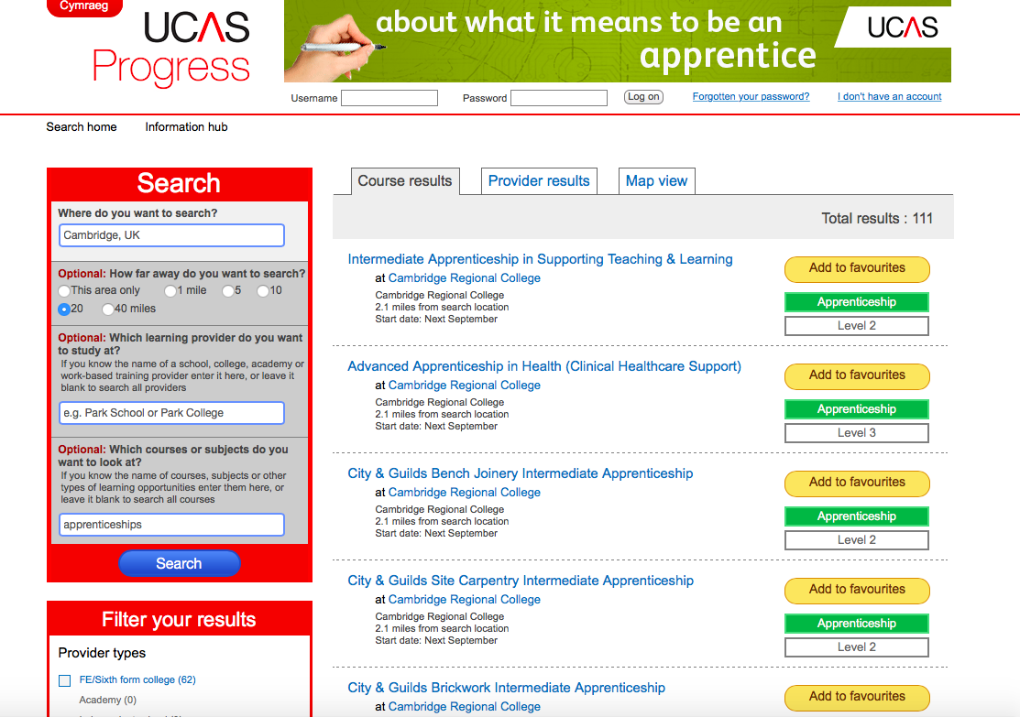
UCAS Progress has some options

Slide 23
Apply through the employer’s website

Slide 24
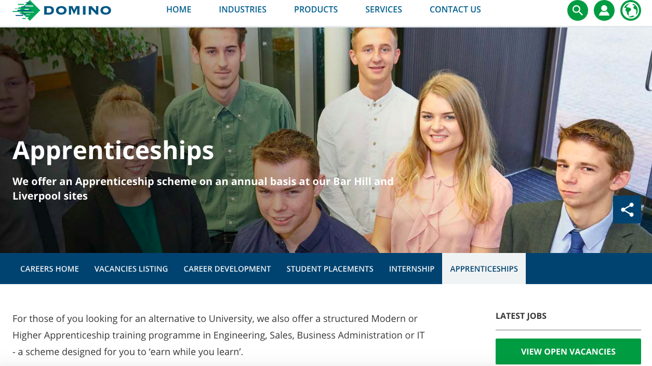

Slide 25
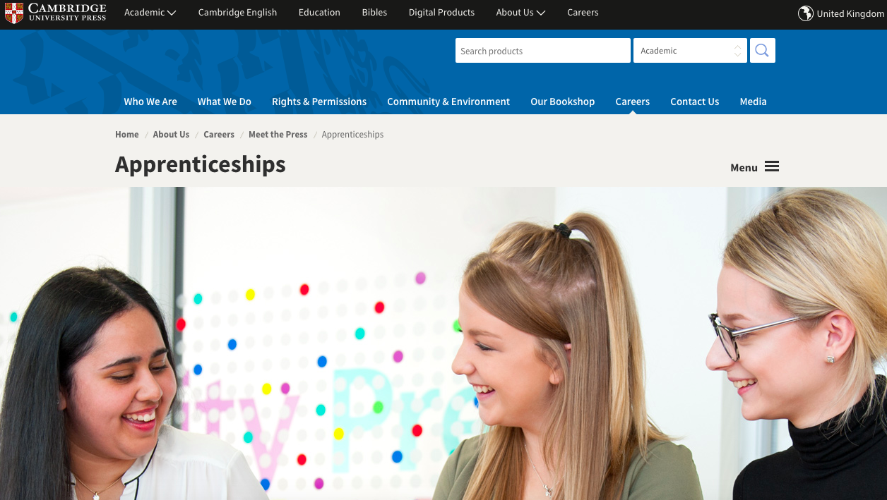

Slide 26
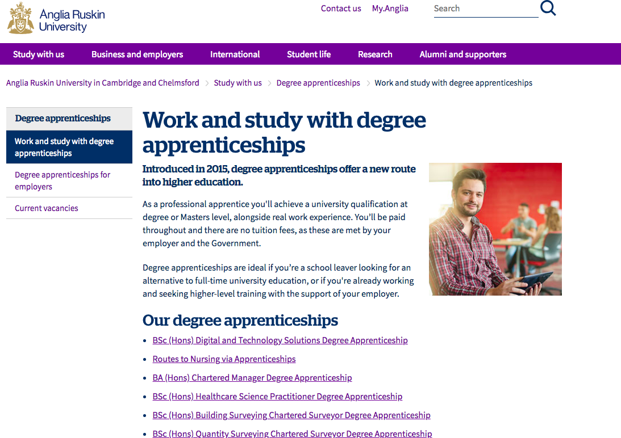

Slide 27
Degree Apprenticeships
BSc (Hons) Digital and Technology Solutions Degree Apprenticeship
Routes to Nursing via Apprenticeships
BA (Hons) Chartered Manager Degree Apprenticeship
BSc (Hons) Healthcare Science Practitioner Degree Apprenticeship
BSc (Hons)
Building Surveying Chartered Surveyor Degree Apprenticeship
BSc (Hons)
QuantitySurveying Chartered Surveyor

Slide 28
Coming soon – TBC
Senior Leader
Advanced Clinical Practitioner
Civil Engineer
B2B Sales
Digital Marketing
Physician’s Associate
Digitech Business Analyst
Construction
Site Management
Clinical Research
Specialist
Embedded Electronics
Senior Leader Health and Social Care
Police Officer

Slide 29
How Form the Future can help you
Baker clause:
introduce students to providers who can talk about apprenticeships and technical education
Gatsby Benchmarks:
curriculum linked with careers
student encounters with employers
personal guidance
learning from career and labour market information.
Staff training
Parent talks

Slide 30
Anne Bailey
T 01223 781 296
abailey@formthefuture.org.uk

